Slide 1

Object – Oriented Programming
Iksan Bukhori, M.Phil.

Slide 2
Topic 7: Abstract Class and Exception Handling

Slide 3
Abstract Class

Slide 4
What is Abstract Class
Abstract class is a class that acts as a ‘template’ or ‘blueprint’ for other class(es)
Abstract class cannot be instantiated
It contains one or more abstract method, which is a method without implementation, thus any class inherited from this abstract class should provide implementation of such method

Slide 5
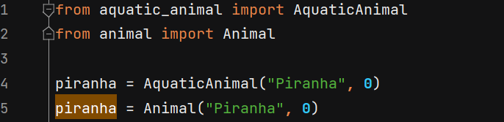
Abstract Class: Example
Let’s say that we have animal class with child class LandAnimal, AquaticAnimal, and FlyingAnimal (see the classes provided by your instructor)
As you can see now, you can create instance of the child class or the instance of the parent class (Animal)
If you want to prevent any object to be created from the parent class (any object should only be the instance of the child class), you can make parent class to be abstract class

Slide 6
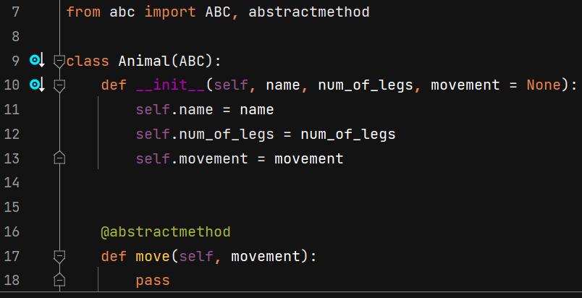
Abstract Class: Abstract Method
In Python, in order to create an abstract class, first we need to import Abstract Base Class (ABC) and abstract method
Then we can have the parent class that we want to be abstract to “inherit” from this ABC
Then we can define the methods that need to be abstract method by using decorator @abstractmethod
This way, Animal class achieve two characteristics:
No instance can be created from it
Every class that is inherited from Animal class should provide the implementation of move() method

Slide 7
Abstract Method: Subtleties You Need to Be Careful About
Abstract method can still be called from the child class using super()
Constructor is a method thus it can be made abstract too. However please note that abstract constructor means that every child class should have their own implementation of constructor
You can create implementation of abstract method in abstract class, however this implementation will be ignored if an instance of the child class of this abstract class is calling method of that name
If an abstract method is supposed to be class method or static method, the class method / static method decorator needs to be declared before abstract method decorator

Slide 8
Abstract Property
Remember that a property is a special method that can be used to access the attribute as if we access it directly without any method
As such, property can also be made abstract
Similar to creating abstract static/class method, when creating abstract property it is important to declare the property decorator before the abstract method decorator
Similar to other type of abstract method, declaring a property as abstract push the requirement of implementation towards the child classes

Slide 9
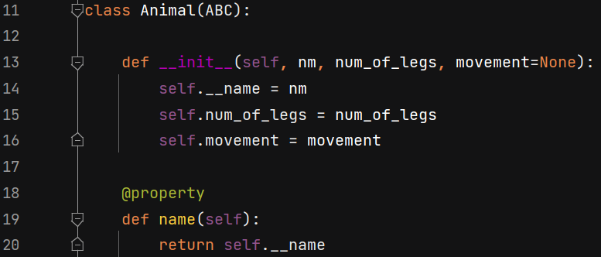
Subtleties using Abstract Property, inheritance, and super().__init__
Let’s try to create property for name attribute in Animal class, and as usual declare name attribute as private

Slide 10
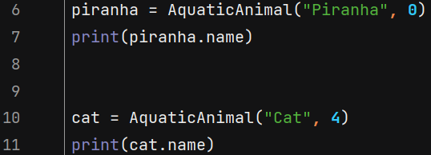
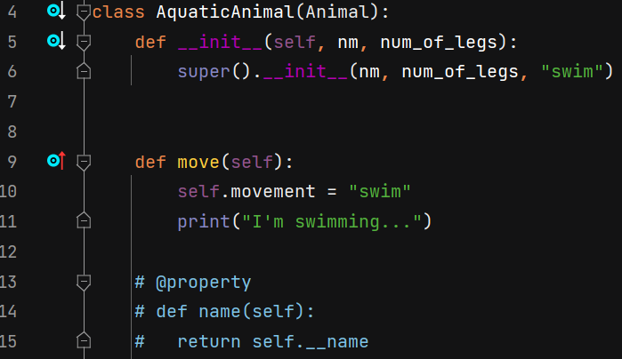
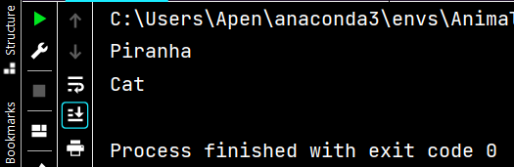
Subtleties using Abstract Property, inheritance, and super().__init__
In subclass AquaticAnimal, we do not have to create property, since it has been handled by the superclass Animal and thus should work properly according to how inheritance works

Slide 11
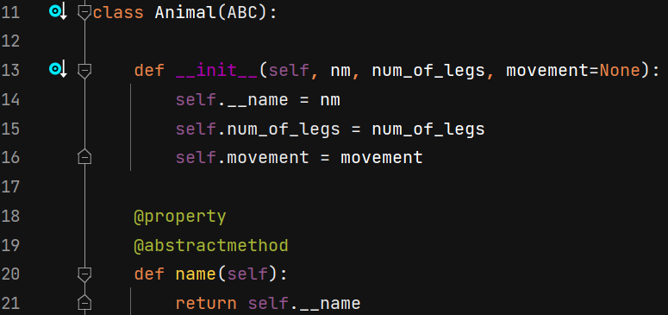
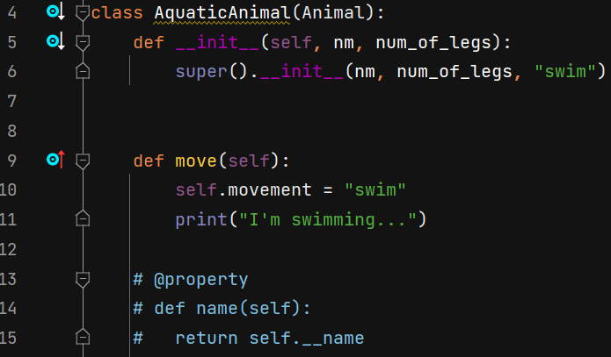
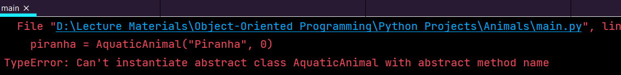
Subtleties using Abstract Property, inheritance, and super().__init__
Now, let’s make the Name property in Animal Class abstract
As expected, without implementation of name property, we get error when trying to instantiate AquaticAnimal (See image on the right)

Slide 12
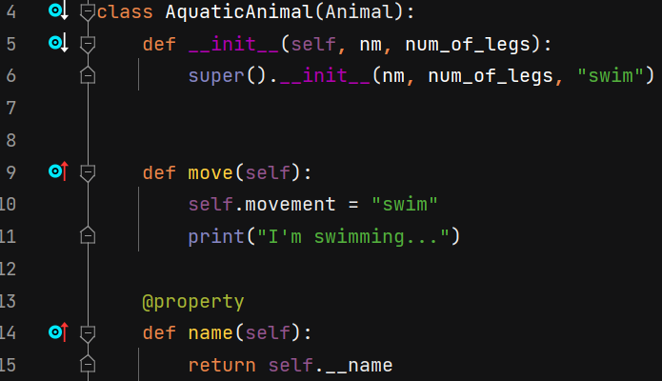

Subtleties using Abstract Property, inheritance, and super().__init__
Let’s see what happens if we implement name property in AquaticAnimal
We still got an error! (See image on the right)

Slide 13
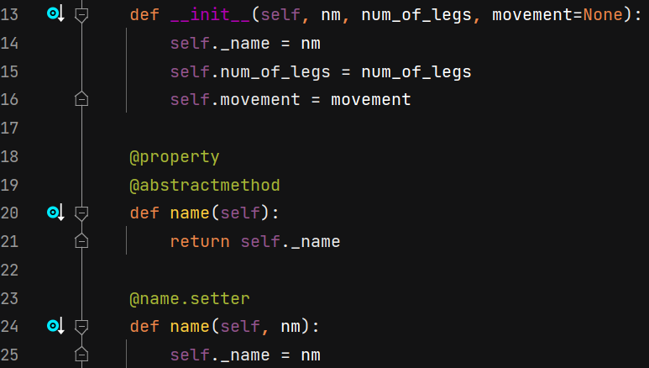
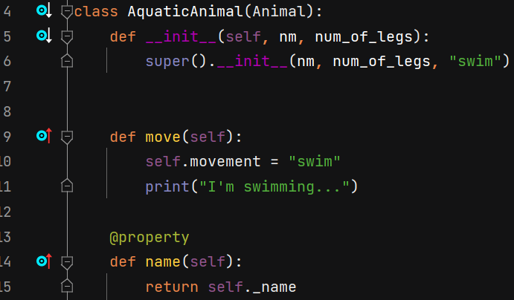

Subtleties using Abstract Property, inheritance, and super().__init__ : private vs protected
This problem occurs because attribute name is set to be private, thus is inaccessible from the child class. To fix this problem, we can modify name attribute to be protected
Problem is fixed!(See image on the right)

Slide 14
Additional note for Property
The name of the property (on the property header) should be different from the name of the attribute it represents
That is why, we typically use private ‘modifier’ (appending double underscore in front of attribute) or in the previous slide protected ‘modifier’ (appending single underscore in front of attribute)
Having the same property name with the attribute’s name will cause recursion error

Slide 15
Clearing up the terminologies
Abstract Class: Class which has one or more abstract methods. We cannot instantiate from this class
Concrete Class: Class which implements the abstract class by defining the implementations of the abstract methods. We can instantiate from this class
Abstract Method: Method that has no implementation (or its implementation is ignored when being called from the instance of child class if the abstract method decorator preceded the method header)

Slide 16
Exception Handling
The source for this section is mostly taken from Exceptions in Python

Slide 17
Exceptions in Python
Exception is an event that is considered abnormal from the point of view of the programmer, for example due to the wrong given data type, input is beyond the intended range, etc.
When Python encounters these exceptions, the interpreter stop the current process and passes it to the calling process until it is handled. If not handled, the program will crash.

Slide 18
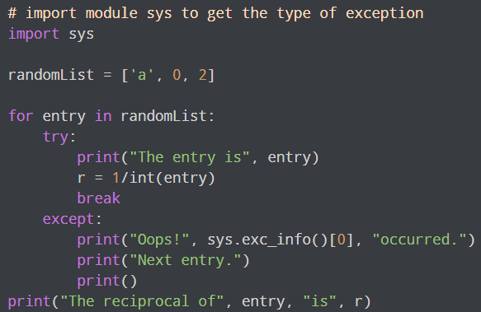
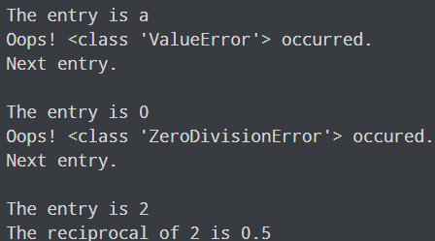
Catching Exceptions
In Python, exceptions can be handled using a try statement.
The critical operation which can raise an exception is placed inside the try clause. The code that handles the exceptions is written in the except clause.
We can thus choose what operations to perform once we have caught the exception.

Slide 19
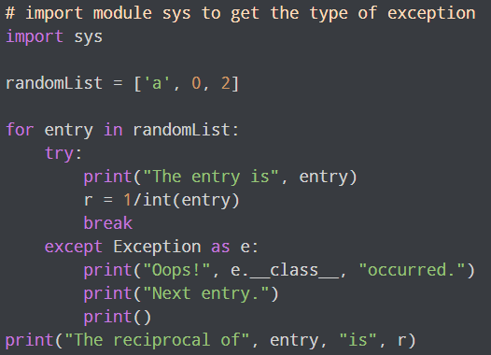
Catching Exceptions
Since every exception in Python inherits from the base Exception class, we can also perform the above task in the following way:

Slide 20
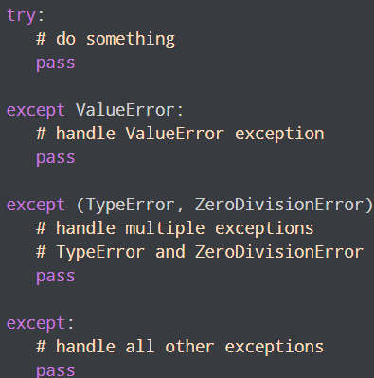
Catching Specific Exceptions
In the previous example, we did not mention any specific exception in the except clause.
This is not a good programming practice as it will catch all exceptions and handle every case in the same way. We can specify which exceptions an except clause should catch.
A try clause can have any number of except clauses to handle different exceptions, however, only one will be executed in case an exception occurs.
We can use a tuple of values to specify multiple exceptions in an except clause. Here is an example pseudo code.

Slide 21
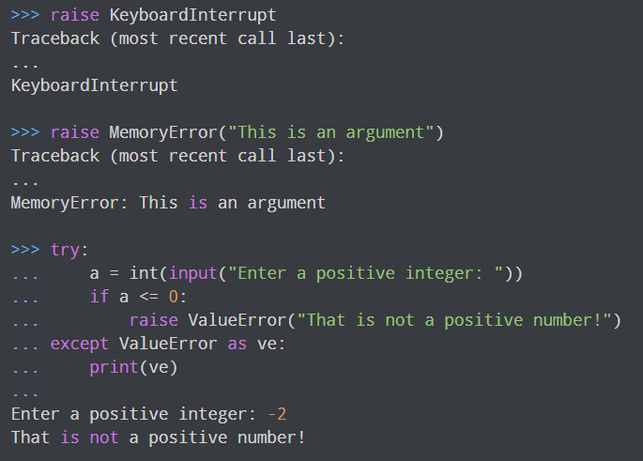
Raising Exceptions Manually
In Python programming, exceptions are raised when errors occur at runtime. We can also manually raise exceptions using the raise keyword.
We can optionally pass values to the exception to clarify why that exception was raised.

Slide 22
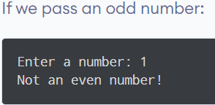
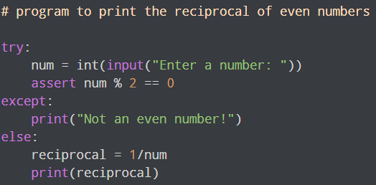
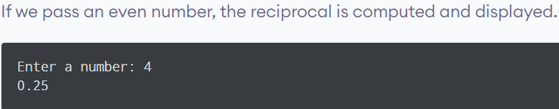
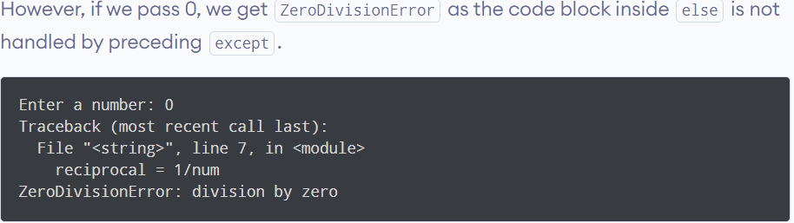
Python try...else
In some situations, you might want to run a certain block of code if the code block inside try ran without any errors. For these cases, you can use the optional else keyword with the try statement.

Slide 23
Python try...finally
The try statement in Python can have an optional finally clause. This clause is executed no matter what, and is generally used to release external resources.
For example, we may be connected to a remote data center through the network or working with a file or a Graphical User Interface (GUI).
In all these circumstances, we must clean up the resource before the program comes to a halt whether it successfully ran or not. These actions (closing a file, GUI or disconnecting from network) are performed in the finally clause to guarantee the execution.
Here is an example of file operations to illustrate this.

Slide 24
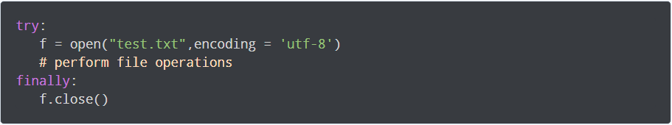
Python try...finally

